Slide 1
ISO 27001:2005
Information Security Management System (ISMS)

Slide 2
Course Content
Introduction to ISO 27001
Purpose and intent of the 27001 standard
Requirements of ISO 27001:2005

Slide 3
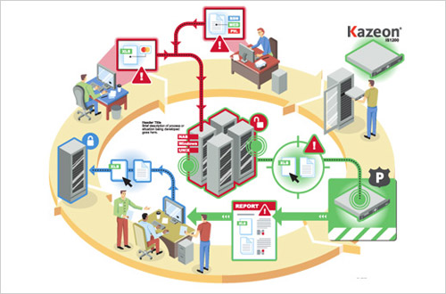
What is ISMS?
That part of the overall management system, based on a business risk approach, to establish, implement, operate, monitor, review, maintain and improve information security.
(ISO/IEC 27001:2005 Clause 3.7)

Slide 4
What is ISMS?
That part of the overall management system, based on a business risk approach, to establish, implement, operate, monitor, review, maintain and improve information security.
(ISO/IEC 27001:2005 Clause 3.7)

Slide 5
Factors affecting ISMS
INFORMATION SECURITY
MANAGEMENT
Escalating Risk
Insurance
Globalization
Risk tolerance
Legislation
Societal values
Government
Neighbor
NGOs
Competition-
business
Competition - cost
Consumer
Corporate culture
Customer
requirements
Employee
Shareholder
Union
Corporate vision & policy

Slide 6
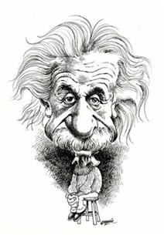
History of ISO 27001
Early 1990s Dept. of Trade and Industry of UK support to develop
1995 First adopted as British Standard (BS)
1998 Certification requirements launched
1999 Second Edition issued
Added e-commerce, m-computer and contract of 3rd party
2000 ISO approved ISO 17799 Part 1 in Aug

Slide 7
History of ISO 27001
2002 BS 7799-2:2002 issued on Sept. 5th
Emphasis consistence with ISO 9001& ISO 14001
Adopted PDCA Model
2003 Over 500 certificated issued
2004 Over 1,000+ certificated worldwide
2005 ISO 27001 released

Slide 8
ISO 17799 / ISO 27001
ISO 17799
Code of practice for information security management
ISO 27001:2005
Information technology – security techniques – Information security management systems – requirements

Slide 9
Related standards and models
ISO/IEC 15408 Information Technology – security techniques – evaluation criteria
ISO/IEC 12207 Software life cycle processes
ISO/IEC 18045 Methodology for IT Security evaluation
ISO/IEC 13569 Banking and related financial services – information security guidelines
ISO/IEC TR 13335 Information technology guidelines for the management of IT security

Slide 10
Related standards and models
ISO/IEC TR 15504 Software process assessment
BS ISO/IEC 90003:2004 Software engineering. Guidelines for the application of ISO 9001:2000 to computer software.
TickIT V5.0 using ISO 9001:2000 for software quality management system construction, certification and continual improvement.
BS 15000 IT service management

Slide 11
Compatibility with other standards
ISO 9001
Quality Management Systems – requirements
ISO 14001
Environmental Management Systems – specification with guidance for use

Slide 12
PURPOSE OF ISO 27001

Slide 13
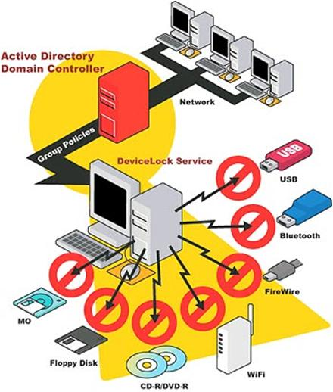
Benefits of ISMS
To protect an organization’s information assets in order to: ensure business continuity, minimize business damage, and maximize return on investments
Internationally recognized, structured methodology
Defined process to evaluate, implement, maintain, and manage information security,
Tailored policies, standards, procedures, and guidelines

Slide 14
Benefits of ISMS
Efficient and effective security planning and management
Increased credibility, trust and confidence of partners and customers
Compliance to all relevant commitment
Compatibility with other standards

Slide 15
Information security concepts
Accountability
Non-Repudiation
Confidentiality
Availability
Reliability
Accountability
Integrity

Slide 16
Plan-Do-Check-Act cycle & Continual Improvement
Take actions to continually improve process performance – effectiveness and efficiency
Establish objectives necessary to deliver results in accordance with customer requirements and the organization’s policies
Monitor and measure processes and product against policies, objectives and requirements
Implement the processes

Slide 17
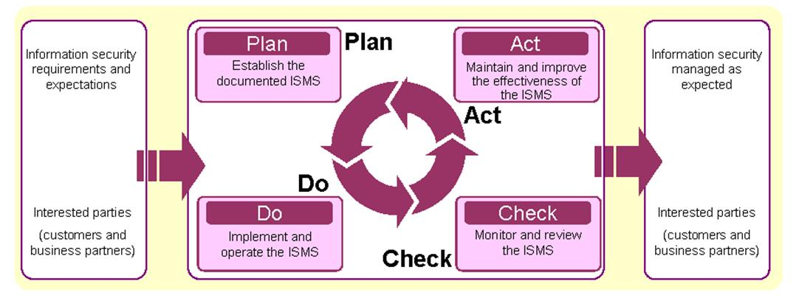
PDCA Model applied to ISMS processes

Slide 18
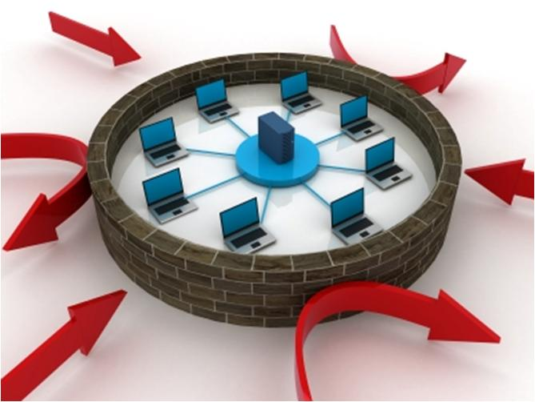
ISO 27001 REQUIREMENTS

Slide 19
ISO 27001 REQUIREMENTS

Slide 20
ISO 27001 Requirements
1 Scope
1.1 General
1.2 Application
2 Normative References
3 Term and definitions
4 Information security management system
4.1 General requirements
4.2 Establishing and managing the ISMS
4.3 Documentation requirements

Slide 21
ISO 27001 Requirements
5 Management Responsibility
5.1 Management commitment
5.2 Resource management
6 Internal ISMS audits
7 Management review of the ISMS
7.1 General
7.2 Review input
7.3 Review output

Slide 22
ISO 27001 Requirements
8 ISMS Improvement
8.1 Continual improvement
8.2 Corrective action
8.3 Preventive action

Slide 23
ISO 27001 Requirements
Annex A (normative)
Control objectives and controls
Annex B (informative)
OECD principles and this International Standard
Annex C (informative)
Correspondence between BS EN ISO 9001:2000, BS EN ISO 14001:1996 and ISO 27001:2005

Slide 24
Scope
Requirements for
Establishing
Implementing
Operating
Monitoring
Reviewing
Maintaining and
Improving
A documented ISMS w/in the context of the organization’s overall business risks

Slide 25
Scope
ISMS is designed to ensure
the selection of adequate and proportionate security controls that protect information assets and give confidence to interested parties.

Slide 26
Application of the standard
Generic
Applicable to all organizations
Exclusions:
do not affect the ability or responsibility to provide information security that meets security requirements as determined by risk assessment and regulatory requirements
must be justified and evidence provided that associate risks are acceptable
Requirements in clauses 4, 5, 6, 7 and 8 cannot be excluded

Slide 27
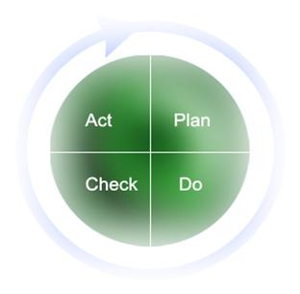
ISO 27001; Clause 4
4
Information Security Management System
4.1
General Requirements
4.2
Establish and manage the ISMS
4.3
Documentation requirements
4.2.1
Establishing the ISMS
4.3.1
General
4.2.2
Implement and operate the ISMS
4.3.2
Control of documents
4.1
Monitor and review the ISMS
4.3.3
Control of records
4.1
Maintain and improve the ISMS

Slide 28
4.1 General Requirements
Establish the ISMS
Implement the ISMS
Operate the ISMS
Monitor the ISMS
Review the ISMS
Maintain the ISMS
Improve the ISMS

Slide 29
4.2 Establishing and managing the ISMS
4.2.1 Establish the ISMS
Define the scope and boundaries of the ISMS
Define and ISMS policy that:
includes the framework for setting objectives and establishes an overall sense of direction
takes into account business and legal requirements, and contractual security obligations
aligns with the strategic risk management context
establishes criteria against which risk will be evaluated
has been approved by management

Slide 30
4.2 Establishing and managing the ISMS
4.2.1 Establish the ISMS
Risk assessment approach
suited to the ISMS, and the identified business information security, legal and regulatory requirements
criteria for accepting risks and identify the acceptable levels of risks
Risk identification
assets w/in the scope of the ISMS, and the owners of these assets
threats to those assets
vulnerabilities that might be exploited by the threats
impacts that losses of confidentiality, integrity and availability may have on the assets

Slide 31
Asset classification
Information assets
Database
Procedures
Training material
Paper documents
Inventory list
Contracts
Software assets
Application software
System software
Case too
Physical assets
Computers
Fax machines
Air-conditioning units
Building
Network devices
Goods
People
Staffs
Customers
Subscribers
Service
Heating
Network
Telecom
Power
Air-condition
Pipe water
Intangibles
Goodwill / reputation
Organization confidence
Organization image
Money

Slide 32
4.2 Establishing and managing the ISMS
4.2.1 Establish the ISMS
Risk analysis
Business impacts upon the organization that might result from security failures
Realistic likelihood of security failures occurring and controls currently implemented
Estimate he levels of risks
Determine whether the risks are acceptable or require treatment
Risk treatment
Applying appropriate controls
Accepting risks
Avoiding risks
Transferring risks to other parties, e.g. insurers

Slide 33
4.2 Establishing and managing the ISMS
4.2.1 Establish the ISMS
Select control objectives (ref. Annex A)
Residual risks and management approval
Authorization to implement
Statement applicability
Control objectives and controls selected
Control objectives and controls currently implemented
Exclusion of any control objectives and controls and the justification for their exclusion

Slide 34
4.2 Establishing and managing the ISMS
4.2.2 Implement and operate
Formulate Risk Treatment Action Plan
Implement Risk Treatment Action Plan
Implement controls selected
Define how to measure the effectiveness of the controls
Implement training and awareness programmes
Manage Operations
Manage Resources
Information Security Incidents and Response

Slide 35
4.2 Establishing and managing the ISMS
4.2.3 Monitor and Review
Execute monitoring and reviewing procedures
Review effectiveness of the ISMS
Measure the effectiveness of controls
Review risk assessments at planned intervals
Conduct internal ISMS audits at planned intervals
Undertake a management review of the ISMS
Update security plans
Records actions and events that could have an impact on the performance of the ISMS

Slide 36
4.2 Establishing and managing the ISMS
4.2.4 Maintain and improve
Implement the identified improvements
Take CA/PA
Communicate improvements
Ensure improvements achieve intended objectives

Slide 37
4.3 Documentation
4.3.1 General
Documented statements of security policy and objectives
Scope of the ISMS
Procedures and controls to support ISMS
Mandatory procedures: control of documents, internal ISMS audits, corrective action, preventive action
Description of risk assessment methodology
Risk assessment report
Risk treatment plan
The mandatory documented procedures
Records
Statement of applicability
The extent of the documentation will depend upon the size of organization and type of activities, scope, and complexity of security requirements and the system being managed.

Slide 38
4.3 Documentation
4.3.2 Control of documents
Approved documents for adequacy prior to issue
Review and updated documents as necessary and re-approve documents
Ensure that changes and the current revision status are identified
Ensure that relevant versions are available at points of use
Legible and readily identifiable
Documents are available to those who need them
Documents of external origin are identified

Slide 39
4.3 Documentation
4.3.2 Control of documents
Distribution of documents is controlled
Prevent unintended use of obsolete documents
Identification of obsolete documents

Slide 40
4.3 Documentation
4.3.3 Control of records
Establish conformity to the requirements and effective operation of ISMS
Should be
controlled
legible
readily identifiable
retrievable
Ex: visitors’ book, audit reports and completed authorization forms

Slide 41
ISO 27001; Clause 4
5
Management responsibility
5.1
Management commitment
5.2
Resource management
5.2.1
Provision of resources
5.2.2
Training, awareness and competence

Slide 42
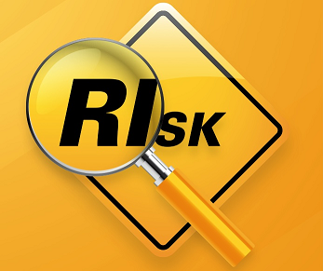
5.1 Management Commitment
Shall provide evidence:
Establish ISMS policy
Objectives and plans
Roles and responsibilities
Communicating to the organization the importance of meeting the objectives and conforming to the policy, responsibilities under the law, and need for continual improvement
Sufficient resources
Deciding the criteria for accepting risks and acceptable levels of risk
ISMS audits are conducted
Conducting management review

Slide 43
5.2 Resource Management
5.2.1 Provision of Resources
The organization shall determine and provide resources needed
5.2.2 Training, awareness and competence
Determine the competencies for personnel
Providing training or taking other actions to satisfy these needs
Evaluating effectiveness of the actions
Maintaining records of education, training, skills, experience and qualifications

Slide 44
ISO 27001; Clause 6
6.0 Internal ISMS audit
Planned intervals to determine:
Conformance to the standard and relevant legislations and regulations
Conformance to ISMS
Effectiveness of implementation
Performance against plans
Criticality or importance of process
Auditor qualification
Auditor independence
Corrective action
ISO 19011:2002

Slide 45
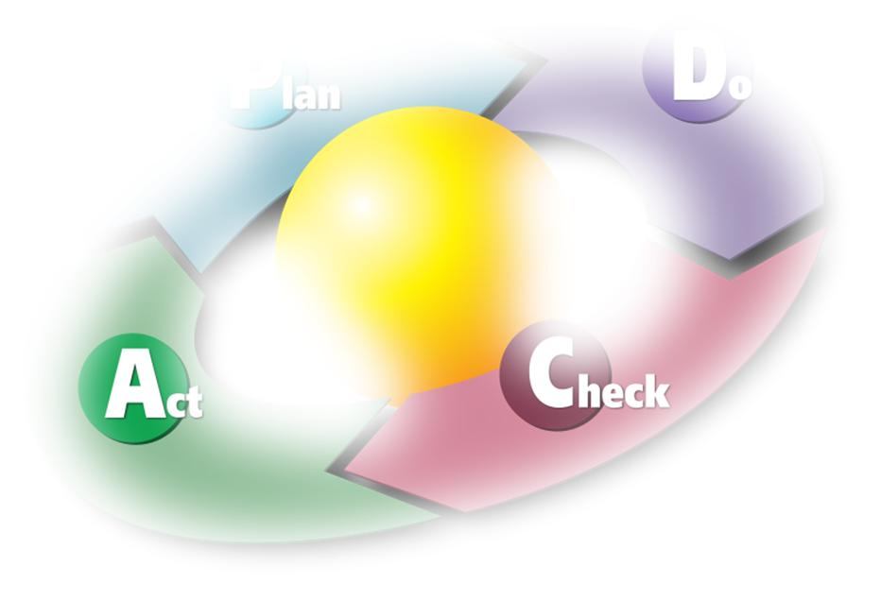
Audit programme management
Authority for programme
Establish programme:
objectives/extent
procedure
resources
responsibilities
Plan
Improve programme
Act
Implement programme:
Schedule audits
Develop audit plans
Evaluate auditors
Select audit teams
Direct audit activities
Maintain records
Do
Monitor and review programme
Check

Slide 46
ISO 27001; Clause 7
7
Management Review of the ISMS
7.1
General
7.2
Review input
7.3
Review output

Slide 47
7.1 General
Management shall review the organization’s ISMS:
Frequency
Opportunities for improvement
Documented and records maintained

Slide 48
7.2 Review Input
Management review input shall include:
Results of ISMS audits and reviews
Feedback from interested parties
Techniques, products or procedures, which could be used in the organization to improve the ISMS performance and effectiveness
Status of preventive and corrective actions
Vulnerabilities or threats not adequately addressed in the previously risk assessment
Results from effectiveness measurements
Follow-up actions from previous management reviews
Any changes that could affect the ISMS
Recommendations for improvement

Slide 49
7.3 Review Output
Management review output shall include:
Improvement of the effectiveness of the ISMS
Update of the risk assessment and the risk treatment plan
Modification of procedures and controls that effect information security
Resource needs
Improvement to how the effectiveness of the controls is being measured

Slide 50
ISO 27001; Clause 8
8
ISMS Improvement
8.1
Continual improvement
8.2
Corrective action
8.3
Preventive action

Slide 51
8.1 Continual Improvement
Opportunities for improvement form analysis of data and performance of ISMS
Continual improvement through:
execution of monitoring procedures
review of effectiveness of ISMS
security policy and objectives
security controls
security audits
incidents, suggestions, feedback

Slide 52
8.1 Continual Improvement
Continual improvement through (cont’d):
review of level of residue risk and acceptable risk
internal ISMS audits
management review
records of actions and events

Slide 53
A nonconformity
May be a failure to:
Comply with the standard
Implement a process or other documented requirement
Implement a legal or contractual requirement
No requirement = no nonconformity

Slide 54
8.2 Corrective Action
Action to eliminate the cause of NC with the ISMS requirements in order to prevent recurrence
Documented procedure shall define requirements for:
Identify NCs
Determine the causes of NCs
Evaluate the need for actions to ensure that NCs do not recur
Determine and implement the corrective action needed
Recording results of action taken
Reviewing of corrective action taken

Slide 55
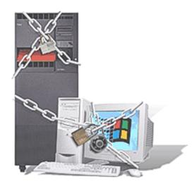
8.3 Preventive Action
Action to eliminate the cause of a potential NC with the ISMS requirements in order to prevent their occurrence
Documented procedure shall define requirements for:
Identify potential NCs and their causes
Evaluate the need for actins to prevent occurrence of NCs
Determine and implement the preventive action needed
Recording results of action taken
Reviewing of preventive action taken

Slide 56
Annex A (Informative)
Control objectives and controls
Derived from, and aligned to, those in BS ISO/IEC 17799
Provide implementation advice and guidance on best practice for controls to meet the specified objectives
Referenced during audit to identify nonconformities and corrective actions

Slide 57
ISO 27001 Certification Process

Slide 58
Audit / Certification Process
Pre-assessment (Optional)
Stage 1: Desk Study
Evaluate the location and site-specific conditions
Collection of information regarding the scope of supply chain SMS, information about risk assessment performed and processes
Relevant ISMS documentation and records
Previous audit reports
Stage 1: Desk Study
Stage 2: Certification Audit
Obtain information and evidence about conformity to all requirements of the applicable normative document
Operational control
Internal auditing and Management review
Surveillance Audits
Maintenance visits
Verify continuous implementation of the system in accordance with the requirements of the standard
Evaluation of the effectiveness of corrective action implementation to previously raised NCs
Stage 2: Certification Audit
Surveillance 1
Surveillance 2
Surveillance 3
Surveillance 3
Surveillance 5

